Slide 1

TRIBHUVAN UNIVERSITY
INSTITUTE OF ENGINEERING
PURWANCHAL CAMPUS
A Major Project Report on
“ AI GENERATED IMAGE AND DEEPFAKE VIDEO DETECTION USING CNN”
Submitted By: Submitted To:
Sulab Nepal (076/BEI/042) Department of Computer And
Shishir Parajuli (076/BEI/035) Electronics Engineering.
Saphal Bhattarai (076/BEI/032) Purwanchal Campus, Dharan
Pushpa Kamal Dahal (076/BEI/026)
Submission Date: 5 March, 2024

Slide 2
INTRODUCTION
Artificial Intelligence (AI) has emerged as a transformative force across various industries, revolutionizing the way we live, work, and interact with technology.
In recent years, AI-powered content generation has gained significant traction, offering unparalleled opportunities for businesses, content creators, and individuals alike.
The rapid advancement of AI-based image generation techniques has led to the increasing need for methods to distinguish between real and AI-generated images.
AI video detection has emerged as a powerful tool across various industries, offering unprecedented capabilities in surveillance, security, entertainment, and more.
2

Slide 3
Project Objectives
To design a system that detects AI generated image and deepfake videos.
To design a system that maintain human authenticity.
3

Slide 4
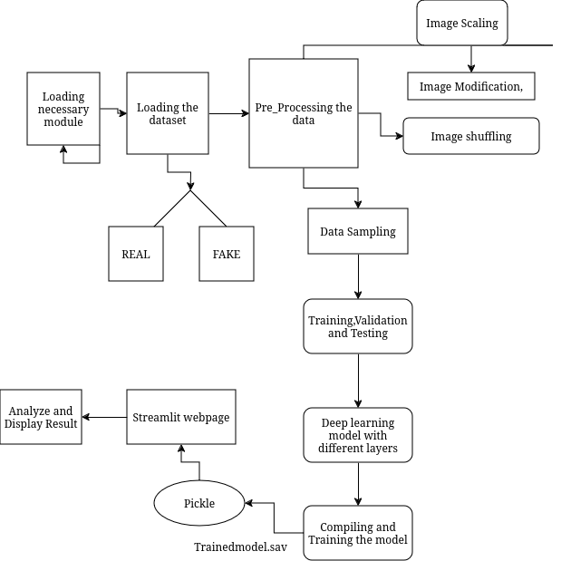

Methodology:
System Block Diagram For AI Generated Image

Slide 5
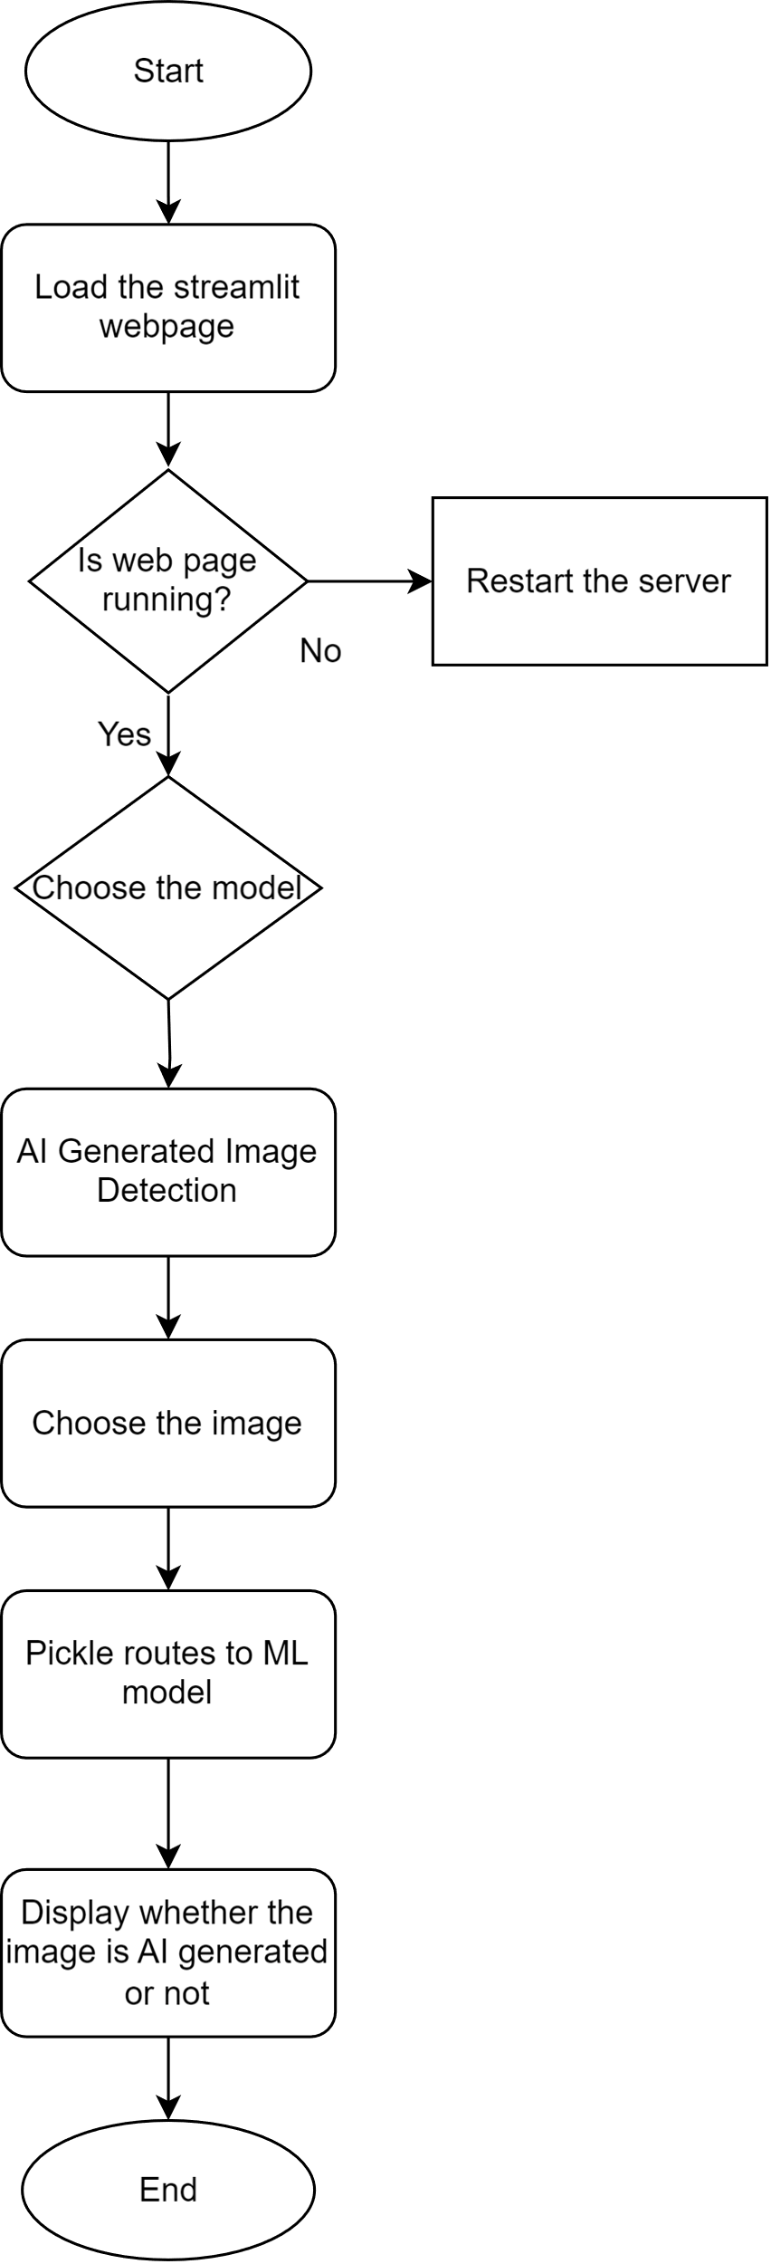
AI Generated Image Detection
5

Slide 6
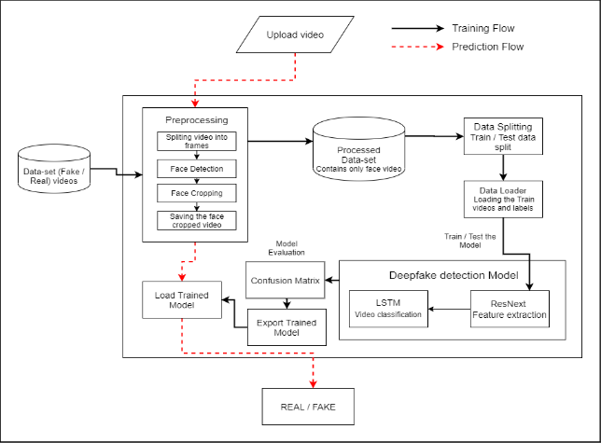
System Block Diagram for Deepfake Detection

Slide 7
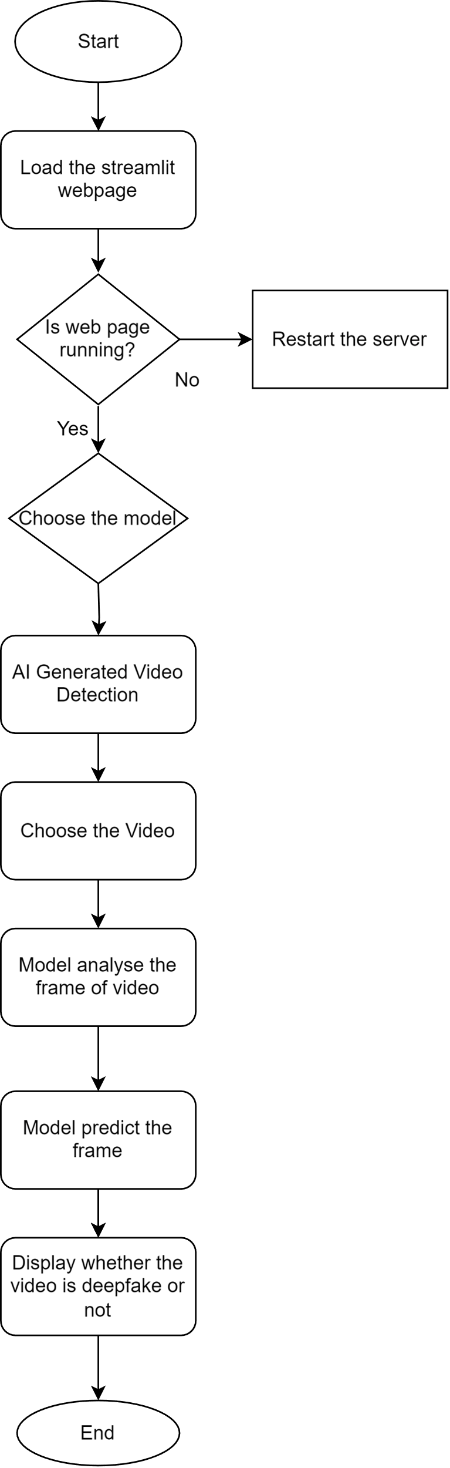
AI Generated Deepfakes Detection
7

Slide 8

Result and Output
AI Generated Image Detection
8

Slide 9
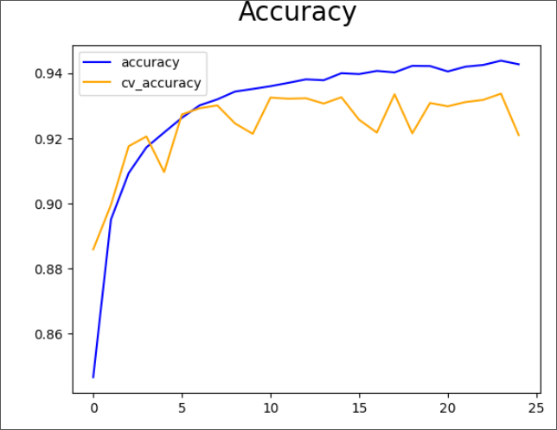
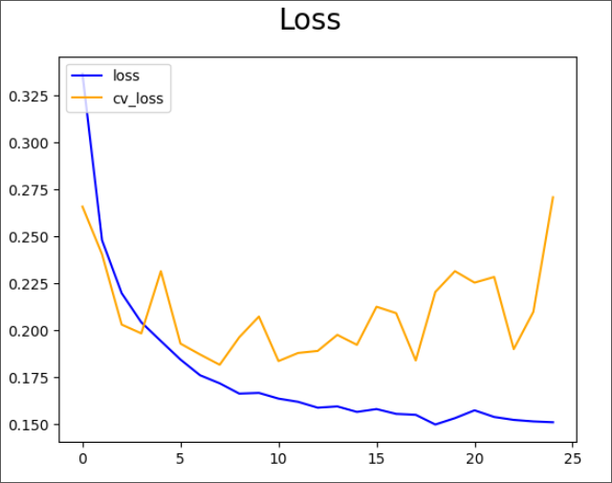
Output Curve
9

Slide 10
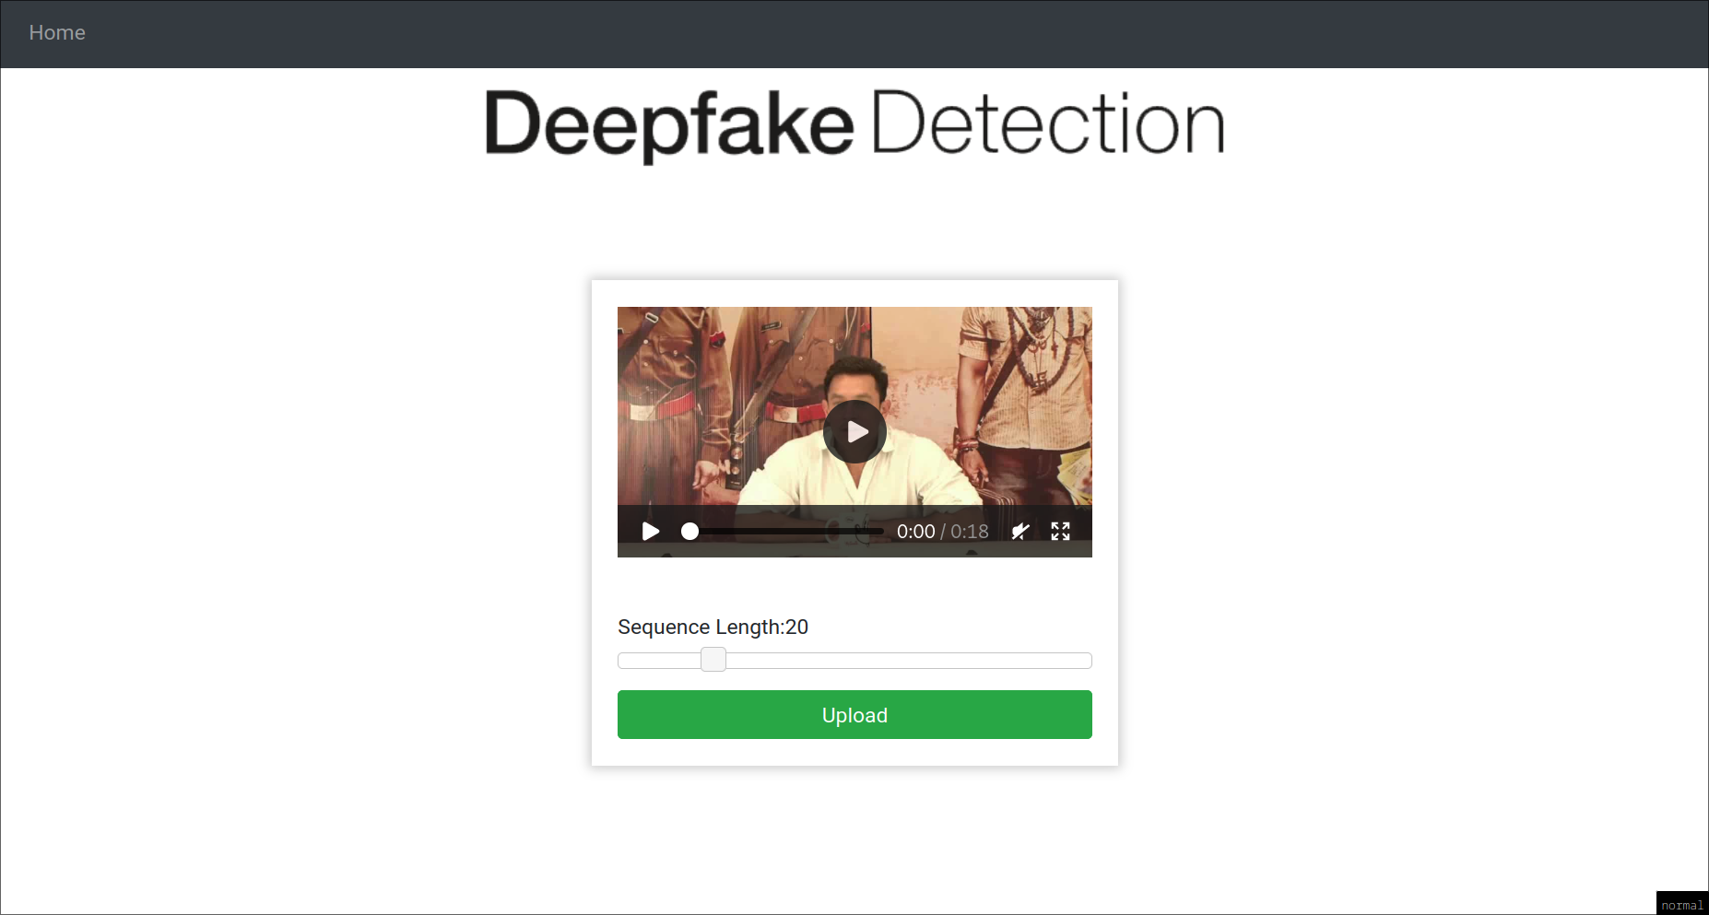
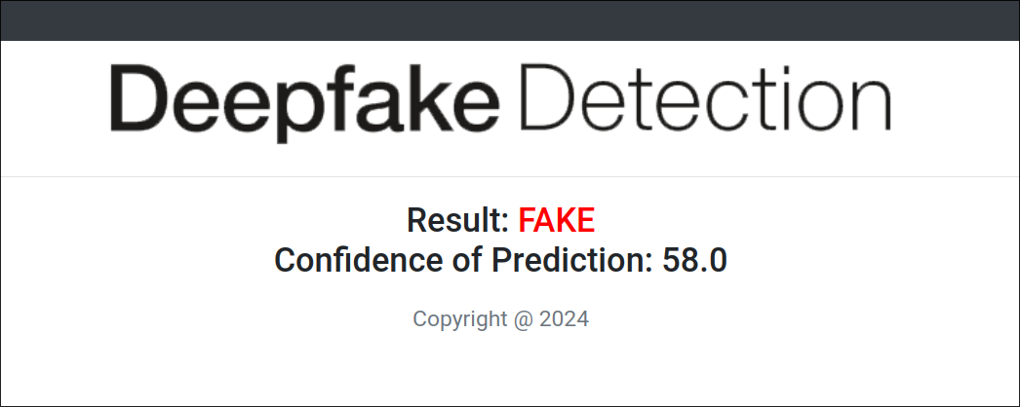
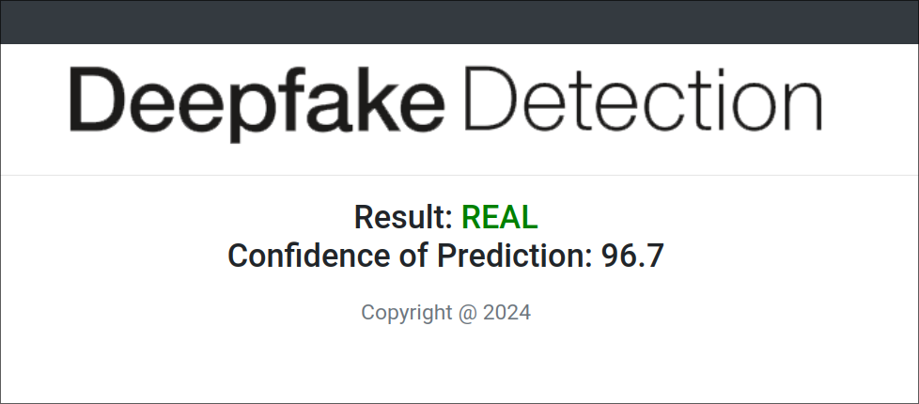
AI Generated Deepfake Video Detection
10

Slide 11
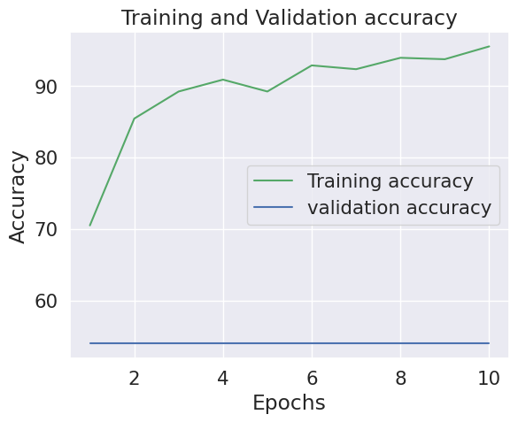
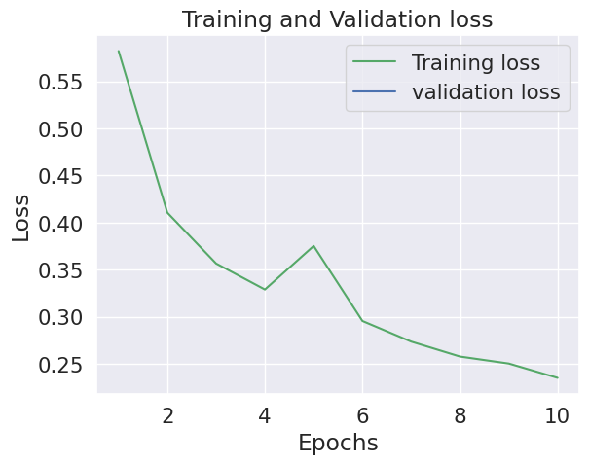
Output Curve
11

Slide 12
Project Applications
Academic Institution
Entertainment Industry
Content Creation and Social Media Platform
Journalism and Media
Political Campaigns and Elections
12

Slide 13
REFERENCES
[1] I. Goodfellow, J. Pouget-Abadie, M. Mirza, B. Xu, D. Warde-Farley, S. Ozair,
A. Courville, and Y. Bengio, “Generative adversarial networks,” Communications
of the ACM, vol. 63, no. 2020, pp. 139–144, 2020.
[2] A. Dosovitskiy, L. Beyer, A. Kolesnikov, D. Weissenborn, X. Zhai, T. Unterthiner,
M. Dehghani, M. Minderer, G. Heigold, S. Gelly, and et al., “An image is
worth 16x16 words: Transformers for image recognition at scale,” arXiv preprint
arXiv:2010.11929, 2020.
[3] X. Guo, X. Liu, Z. Ren, S. Grosz, I. Masi, and X. Liu, “Hierarchical fine-grained
image forgery detection and localization,” in Proceedings of the IEEE/CVF Con-
ference on Computer Vision and Pattern Recognition, 2023, pp. 3155–3165.
[4] K. He, X. Zhang, S. Ren, and J. Sun, “Deep residual learning for image recog-
nition,” in Proceedings of the IEEE conference on computer vision and pattern
recognition, 2016, pp. 770–778.
[5]H. Li, B. Li, S. Tan, and J. Huang, “Identification of deep network generated images
using disparities in color components,” Signal Processing, vol. 174, p. 107616,
2020.
13

